Slide 1
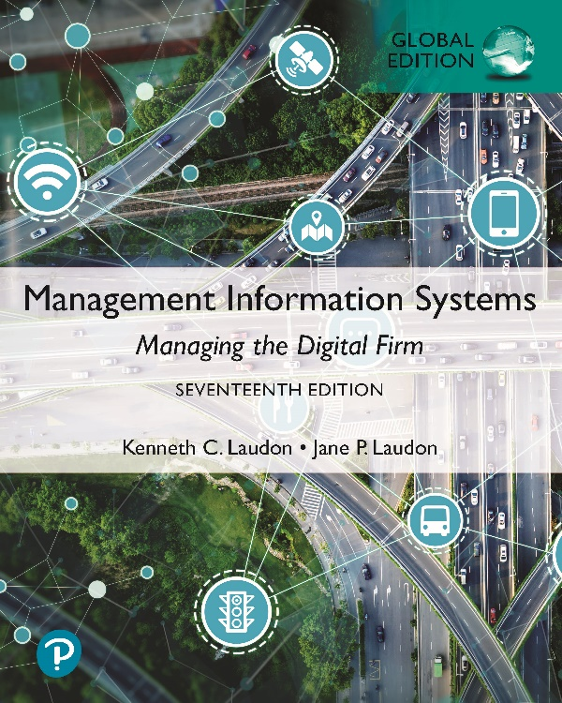
Management Information Systems: Managing the Digital Firm
Seventeenth Edition, Global Edition
Chapter 8
Securing Information Systems
Copyright © 2022, 2020, 2018 Pearson Education, Ltd. All Rights Reserved
Notes:
If this PowerPoint presentation contains mathematical equations, you may need to check that your computer has the following installed:
1) MathType Plugin
2) Math Player (free versions available)
3) NVDA Reader (free versions available)

Slide 2
Learning Objectives
8.1 Why are information systems vulnerable to destruction, error, and abuse?
8.2 What is the business value of security and control?
8.3 What are the components of an organizational framework for security and control?
8.4 What are the most important tools and technologies for safeguarding information resources?
8.5 How will M I S help my career?
Notes:
This chapter discusses the need for security to guard information systems and data, as well as technologies used to secure information systems. Ask students what types of threats can harm an information system. Internet security, or the lack thereof, will continue to be a topic of major concern to corporations and countries. Ask students why there is so much attention paid to Internet security issues in the press. Ask if anyone has been a victim of a breach in computer security.

Slide 3
Video Cases
Case 1: Stuxnet and Cyberwarfare
Case 2: Cyberespionage: The Chinese Threat
Instructional Video 1: Sony PlayStation Hacked; Data Stolen from 77 Million Users
Instructional Video 2: Meet the Hackers: Anonymous Statement on Hacking Sony

Slide 4
Cyberattacks in the Asia-Pacific (1 of 2)
Problem
  Information technology is pervasive
  Social engineering attacks
Solutions
  Educate customers about security practices
  Manage data breaches proactively

Slide 5
Cyberattacks in the Asia-Pacific (1 of 2)
Robust business processes need to be created and monitored
Demonstrates vulnerabilities in information technology systems
Illustrates some of the reasons organizations need to pay special attention to information system security

Slide 6
Why Systems are Vulnerable (1 of 2)
Security
  Policies, procedures, and technical measures used to prevent unauthorized access, alteration, theft, or physical damage to information systems
Controls
  Methods, policies, and organizational procedures that ensure safety of organization’s assets; accuracy and reliability of its accounting records; and operational adherence to management standards
Notes:
This slide introduces the need for both security and controls in today’s businesses in order to safeguard information systems. Ask students to give an example of security technique and an example of a control that might be used in a business.

Slide 7
Why Systems are Vulnerable (2 of 2)
Accessibility of networks
Hardware problems (breakdowns, configuration errors, damage from improper use or crime)
Software problems (programming errors, installation errors, unauthorized changes)
Disasters
Use of networks/computers outside of firm’s control
Loss and theft of portable devices
Notes:
This slide discusses the main categories of threats to information systems. Note that when large amounts of data are stored digitally on computers and servers and in databases, they are vulnerable to many more kinds of threats than when they were stored in manual form, on paper in folders and file cabinets. When data are available over a network, there are even more vulnerabilities. Ask students if they have ever lost data on their computers. What was the reason (hardware, software, “disaster,” other people, etc.). On the other hand, digital records are not vulnerable in ways that manual records in a file cabinet are vulnerable. For instance, you really can’t tell who has accessed manual records, or when, in a physical file. In a database, file access is monitored (unless a hacker has found a way to read records without leaving a digital trail).

Slide 8
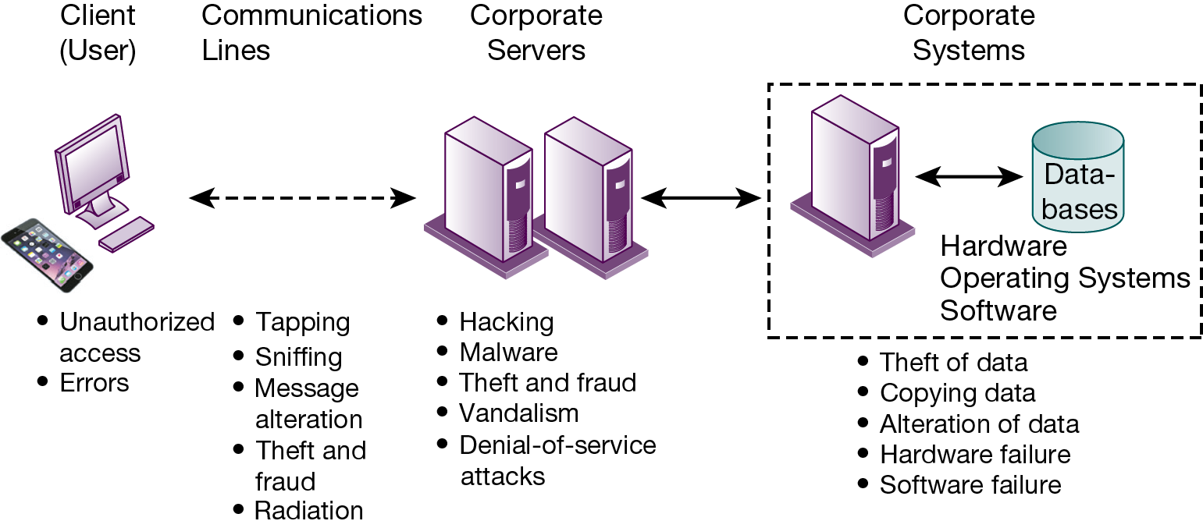
Figure 8.1 Contemporary Security Challenges and Vulnerabilities
Notes:
Figure 8.1, Page 296.
The architecture of a web-based application typically includes a web client, a server, and corporate information systems linked to databases. Each of these components presents security challenges and vulnerabilities. Floods, fires, power failures, and other electrical problems can cause disruptions at any point in the network.
This graphic illustrates the types of threats to system security and the points over the network at which these threats are prevalent. Some problems occur at the client computer, others through the network lines, corporate servers, or in corporate hardware and software.
Alt Text
Long description: An illustration explains the possible security challenges and vulnerabilities at various steps in the architecture of a web-based application. The illustration explains the architecture of a web-based application as follows:
A client or user is interconnected to corporate servers via internet and other networks.
The corporate servers are interconnected to the corporate systems in a dashed enclosure.
The corporate systems are interconnected to a databases tunnel, which include hardware, operating system and software.
All the interconnections are depicted by solid bidirectional arrows, except for the connection between client and internet and other networks. The client and internet and other networks are interconnected via a dashed bidirectional arrow.
The corporate systems and its components are enclosed in a dashed rectangle.
The possible security challenges and vulnerabilities at every step in the architecture are listed below:
Client or User: Unauthorized access; Errors.
Internet and Other Networks: Tapping; Sniffing; Message alteration; Theft and fraud; Radiation.
Corporate Servers: Hacking: Malware; Theft and fraud; Vandalism; Denial of service attacks.
Corporate Systems: Theft of data; Copying data; Alteration of data; Hardware failure; Software failure.

Slide 9
Internet Vulnerabilities
Network open to anyone; size means abuses can have wide impact
Corporate networks linked to Internet more vulnerable
E-mail, IM, and P2P increase vulnerability
  Email: attachments with malicious software; can be used to transmit trade secrets, confidential data
  IM: back door into a secure network
  P2P: can transmit malicious software, expose corporate data
Notes:
This slide discusses the types of threats that large public networks, such as the Internet, face because they are open to virtually anyone. Note that the Internet is so huge that when abuses do occur, they can have an enormously widespread impact. And when the Internet becomes part of the corporate network, the organization’s information systems are even more vulnerable to actions from outsiders. The Internet was not designed at inception to be a “secure” network, such as, for instance, the telephone system network. We all get junk spam telephone calls, but hackers have not been able to take control of your telephone, or systematically disrupt telephone service for individuals.

Slide 10
Wireless Security Challenges
Bluetooth and Wi-Fi networks susceptible to hacking
  Radio frequency bands easy to scan
  S S I Ds (service set identifiers)
    Identify access points, broadcast multiple times, can be identified by sniffer programs
War driving
  Eavesdroppers drive by buildings and try to detect S S I D and gain access to network and resources
  Once access point is breached, intruder can gain access to networked drives and files
Rogue access points
Notes:
This slide discusses security threats related to wireless networks. Local area networks (LANs) using the 802.11 standard can be easily penetrated by outsiders armed with laptops, wireless cards, external antennae, and hacking software. Hackers use these tools to detect unprotected networks, monitor network traffic, and, in some cases, gain access to the Internet or to corporate networks. Ask students if they have connected to the Internet through an unknown wireless network that a person or business had established and left unprotected. Note that there are stronger encryption and authentication systems available for wireless networks but users must install them. Today Wi-Fi routers ship today with pre-installed security protection.

Slide 11
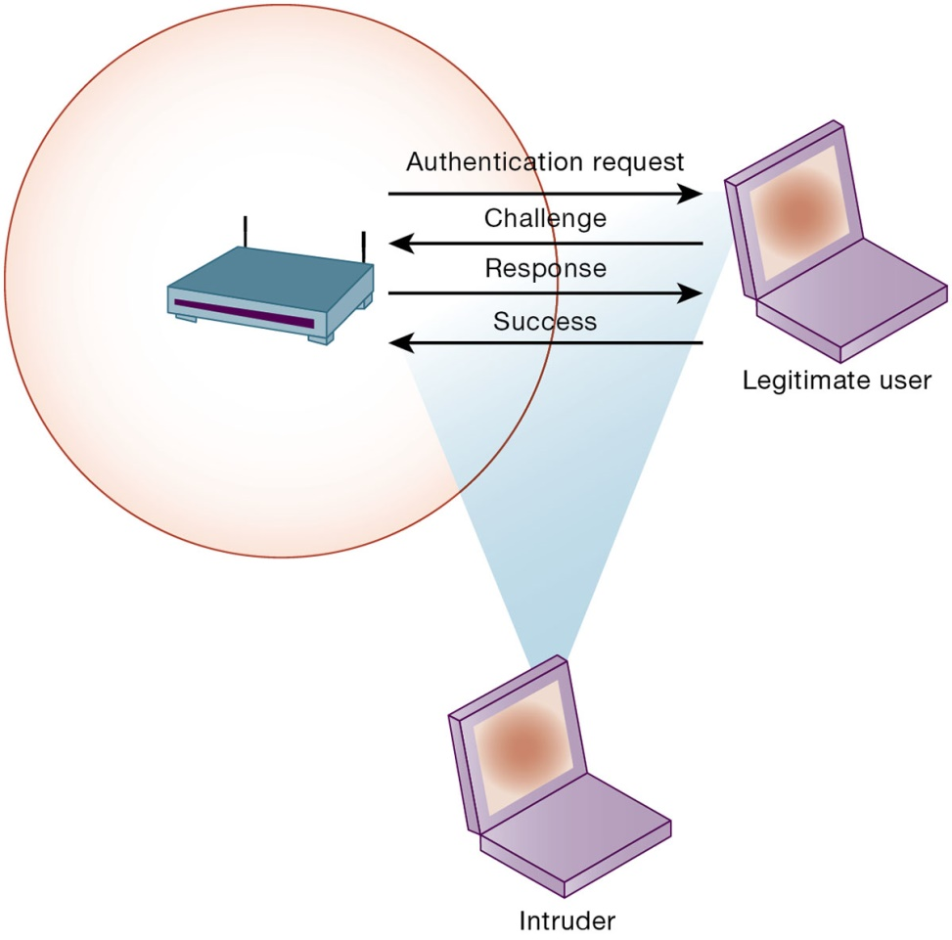
Figure 8.2 Wi-Fi Security Challenges
Notes:
Figure 8.2, Page 297.
Many Wi-Fi networks can be penetrated easily by intruders using sniffer programs to obtain an address to access the resources of a network without authorization.
This graphic illustrates why wireless networks are vulnerable—the service set identifiers (SSIDs) identifying the access points in a Wi-Fi network are broadcast multiple times (as illustrated by the orange sphere) and can be picked up fairly easily by intruders’ sniffer programs.
Alt Text
Long description: An illustration explains security challenges in Wi-Fi. The details of the illustration are as follows:
A router sends authentication request to the legitimate user computer.
The legitimate user communicates the challenge to the router.
The router sends a response to the legitimate user.
Legitimate user sends a success report to the router.
An intruder computer attempts to access the above explained private network between the legitimate user and the router.

Slide 12
Malicious Software: Viruses, Worms, Trojan Horses, and Spyware (1 of 2)
Malware (malicious software)
Viruses
Worms
Worms and viruses spread by
  Downloads and drive-by downloads
  E-mail, I M attachments
Mobile device malware
Social network malware
Notes:
This slide identifies the various types of malware that threaten information systems and computers. Ask students if they have ever had a problem with a virus. Do they know how they got infected? Note that there are now many thousands of viruses and worms targeting mobile phones. Blogs, wikis, and social networks such as Facebook, Twitter, LinkedIn, and Pinterest are new conduits for malware and spyware. Malware is a serious problem—over the past decade, worms and viruses have caused billions of dollars of damage to corporate networks, e-mail systems, and data.

Slide 13
Malicious Software: Viruses, Worms, Trojan Horses, and Spyware (2 of 2)
Trojan horse
S Q L injection attacks
Ransomware
Spyware
  Key loggers
  Other types
    Reset browser home page
    Redirect search requests
    Slow computer performance by taking up memory
Notes:
This slide continues the discussion of types of malware on the previous slide. Note that SQL injection attacks are a significant malware threat. Ask students why this is so. (These attacks enable hackers access to underlying databases that support web applications, such as sales of products and services, e-commerce financial data, and other classified information. In other words, the database is where the information is located. SQL databases have little or no built in security once a hacker gets beyond the entrance point to a corporate network. Ransomware is also proliferating. Ask students if they have heard of any recent ransomware attacks. (One example is an attack on Barnes and Noble in October 2020 that significantly impacted its operations.)

Slide 14
Hackers and Computer Crime (1 of 4)
Hackers v s. crackers
Activities include:
  System intrusion
  System damage
  Cybervandalism
    Intentional disruption, defacement, destruction of website or corporate information system
Spoofing and sniffing
Notes:
This slide looks at the people who commit computer crime, and at the various types of computer crime.
Ask students what the difference is between hackers and crackers and if they agree with the differentiation. Have any students been the victim of computer crime or invasion of privacy?
Ask students what the ultimate purpose of spoofing and sniffing are. Note that there are legitimate uses of sniffing—sniffers can help identify network trouble spots or spot criminal activity on a network. Sniffers can also be used to identify copyrighted data being sent over networks, such as pirated music or video files.

Slide 15
Hackers and Computer Crime (2 of 4)
Denial-of-service attacks (D o S)
Distributed denial-of-service attacks (D D o S)
Botnets
Spam
Notes:
This slide continues the discussion of the types of computer crimes. What is the result of a DDoS attack? The Mirai botnet was responsible for a large scale DDoS attack that disrupted the operations of Etsy, Netflix, and other major websites. Bots and botnets are an extremely serious threat because they can be used to launch very large attacks using many different techniques.

Slide 16
Hackers and Computer Crime (3 of 4)
Computer crime defined by U.S. Department of Justice as any violations of criminal law that involve a knowledge of computer technology for their perpetration, investigation, or prosecution.
Computer may be target of crime
Computer may be instrument of crime
Notes:
This slide looks at legal definition of computer crime and the two main classes of computer crime. The text lists a variety of other examples for computers as targets and as instruments of crime. Ask the students to provide more examples. Have any students encountered any of these types of crimes personally?
Note that the U.S. Congress addressed the threat of computer crime in 1986 with the Computer Fraud and Abuse Act. This act makes it illegal to access a computer system without authorization. The text lists other legislation to counter computer crime, such as the National Information Infrastructure Protection Act in 1996 to make virus distribution a hacker attacks to disable websites federal crimes.
According to the Ponemon Institute, the median annual cost of cybercrime for organizations in their study was $13 million. However, many companies are reluctant to report computer crimes. Why? What are the most economically damaging types of computer crime? (DoS, activities of malicious insiders, and web-based attacks.)

Slide 17
Hackers and Computer Crime (4 of 4)
Identity theft
  Phishing
  Evil twins
  Pharming
Click fraud
Cyberterrorism
Cyberwarfare
Notes:
This slide continues the discussion of types of computer crime. Identify theft is a growing problem and is often the result of hackers employing various phishing techniques.
Ask students if there should be legislation outlawing click fraud.
Note that cybercriminal activities are borderless: The global nature of the Internet makes it possible for cybercriminals to operate anywhere in the world. One concern is the use of computer attacks by organized governments, and that such attacks might target major infrastructure such as electrical grids. The text says that at more than 30 countries, including China, are believed to be developing offensive and defensive cyberwarfare capabilities. One of the leading, if not the leading, countries in cyberwarfare is the United States.

Slide 18
Internal Threats: Employees
Security threats often originate inside an organization
Inside knowledge
Sloppy security procedures
  User lack of knowledge
Social engineering
Both end users and information systems specialists are sources of risk
Notes:
This slide looks at another source of security problems—people inside the company with access to the system. Ask students if they have ever worked somewhere with a vulnerable password system. Have they ever revealed to anyone what their password is or was? What are some solutions to password security? Some financial institutions assign users a new password every day, or every hour.

Slide 19
Interactive Session: Technology: Capital One: A Big Bank Heist from the Cloud
Class discussion
  What management, organization, and technology factors were responsible for the Capitol One hack?
  Was this an insider hack? Explain your answer.
  What steps could have been taken to prevent the Capital One hack?
  Should companies handling sensitive data use cloud computing services? Explain your answer.

Slide 20
Software Vulnerability
Commercial software contains flaws that create security vulnerabilities
  Bugs (program code defects)
  Zero defects cannot be achieved
  Flaws can open networks to intruders
Zero-day vulnerabilities
Patches and patch management: repair software flaws
Vulnerabilities in microprocessor design: Spectre, Meltdown
Notes:
This slide looks at security and other vulnerabilities caused by software errors that open networks to intruders. For example, Equifax software was hacked in 2017 resulting in the loss of personal information of over 150 million people. Ask students why complete testing is not possible with large programs.
Microsoft’s service pack upgrades to its operating system and application software are examples of patches. Failure to install Windows and Office Service Packs is one source of security breaches.

Slide 21
What is the Business Value of Security and Control?
Failed computer systems can lead to significant or total loss of business function
Firms now are more vulnerable than ever
  Confidential personal and financial data
  Trade secrets, new products, strategies
A security breach may cut into a firm’s market value almost immediately
Inadequate security and controls also bring forth issues of liability
Notes:
Ask students to give an example of how inadequate security or control can pose a serious legal liability. The text gives the example of Target, which was sued by its customers in a class action lawsuit for allowing hackers to access its systems and steal credit and debit card data for fraudulent purchase.

Slide 22
Legal and Regulatory Requirements for Electronic Records Management
H I P A A
  Medical security and privacy rules and procedures
Gramm-Leach-Bliley Act
  Requires financial institutions to ensure the security and confidentiality of customer data
Sarbanes-Oxley Act
  Imposes responsibility on companies and their management to safeguard the accuracy and integrity of financial information that is used internally and released externally
Notes:
This slide continues the look at the business value of security and control, examining the legal requirements for electronic records management. Note that the Sarbanes-Oxley Act was designed to protect investors after the scandals at Enron, WorldCom, and other public companies. Sarbanes-Oxley is fundamentally about ensuring that internal controls are in place to govern the creation and documentation of information in financial statements. Because managing this data involves information systems, information systems must implement controls to make sure this information is accurate and to enforce integrity, confidentiality, and accuracy.

Slide 23
Electronic Evidence and Computer Forensics
Electronic evidence
  Evidence for white collar crimes often in digital form
  Proper control of data can save time and money when responding to legal discovery request
Computer forensics
  Scientific collection, examination, authentication, preservation, and analysis of data from computer storage media for use as evidence in court of law
  Recovery of ambient data
Notes:
This slide continues the discussion of the business value of security and control. Security, control, and electronic records management are essential today for responding to legal actions. Ask students what the most common form of electronic evidence is (e-mail).
Note that in a legal action, a firm is obligated to respond to a discovery request for access to information that may be used as evidence, and the company is required by law to produce those data. The cost of responding to a discovery request can be enormous if the company has trouble assembling the required data or the data have been corrupted or destroyed. Courts impose severe financial and even criminal penalties for improper destruction of electronic documents. Ask students what ambient data is and to give an example. Given the legal requirements for electronic records, it is important that an awareness of computer forensics should be incorporated into a firm’s contingency planning process.

Slide 24
Information Systems Controls
May be automated or manual
General controls
  Govern design, security, and use of computer programs and security of data files in general throughout organization
  Software controls, hardware controls, computer operations controls, data security controls, system development controls, administrative controls,
Application controls
  Controls unique to each computerized application
  Input controls, processing controls, output controls
Notes:
To improve security for a firm‘s information systems, it is important to create a framework that supports security. This includes establishing information systems controls, understanding the risks to the firm’s information systems, and establishing security policies that are appropriate for the firm. This slide looks at controls used in information systems. Remember that controls are methods, policies, and organizational procedures that ensure safety of an organization’s assets; accuracy and reliability of its accounting records; and operational adherence to management standards. Controls may be manual or automated. Ask students to explain the difference between manual and automated controls (e.g., making sure that computer storage areas are secure vs. automated virus updates). There are two main types of controls: general controls and application controls. General controls apply to all computerized applications. A list of types of general controls appears on the next slide. Ask students what the functions are of the different types of general controls.
This slide examines the second type of information systems controls, application controls. Ask students what each type of application control does. (Input controls check data for accuracy and completeness when they enter the system. There are specific input controls for input authorization, data conversion, data editing, and error handling. Processing controls establish that data are complete and accurate during updating. Output controls ensure that the results of computer processing are accurate, complete, and properly distributed.)

Slide 25
Risk Assessment
Determines level of risk to firm if specific activity or process is not properly controlled
  Types of threat
  Probability of occurrence during year
  Potential losses, value of threat
  Expected annual loss
Notes:
This slide looks at another important factor in establishing an appropriate framework for security and control: risk assessment. Although not all risks can be anticipated and measured, most businesses should be able identify many of the risks they face and understand their potential losses.

Slide 26
Table 8.5 Online Order Processing Risk Assessment
Exposure | Probability of Occurrence | Loss Range (Average) ($) | Expected Annual Loss ($)
Power failure | 30% | $5,000 − $200,000 ($102,500) | $30,750
Embezzlement | 5% | $1,000 − $50,000 ($25,500) | $1,275
User error | 98% | $200 − $40,000 ($20,100) | $19,698
Notes:
The table illustrates sample results of a risk assessment for an online order processing system that processes 30,000 orders per day. The likelihood of each exposure occurring over a one-year period is expressed as a percentage. The expected annual loss is the result of multiplying the probability by the average loss. Ask students to rank the three risks listed here in order of most important to minimize.

Slide 27
Security Policy
Ranks information risks, identifies security goals and mechanisms for achieving these goals
Drives other policies
Acceptable use policy (A U P)
  Defines acceptable uses of firm’s information resources and computing equipment
Identity management
  Identifying valid users
  Controlling access
Notes:
This slide looks at the need for a firm to establish a security policy for protecting a company’s assets, as well as other company policies the security policy drives, and how information systems support this. Ask students what types of issues would be covered under an AUP. (Privacy, user responsibility, and personal use of company equipment and networks, unacceptable and acceptable actions for every user, and consequences for noncompliance.)
This slide looks at the area of security policy involved in managing identities of system users. Ask students why businesses consider it important to specify which portion of an information system a user has access to? What kinds of information requires very high levels of security access? What rules might be used to determine access rules? One rule is “need to know.”

Slide 28
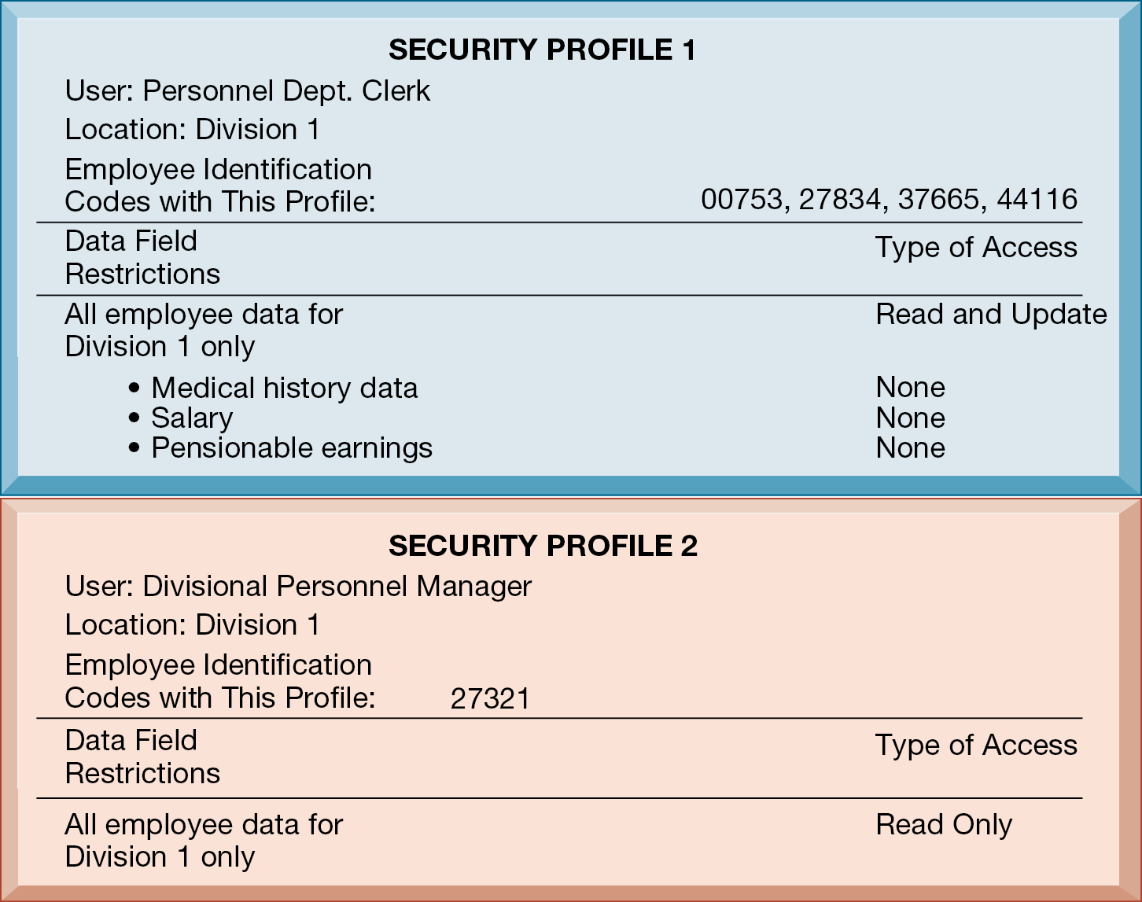
Figure 8.3 Access Rules for a Personnel System
Notes:
Figure 8.3, Page 312.
These two examples represent two security profiles or data security patterns that might be found in a personnel system. Depending on the security profile, a user would have certain restrictions on access to various systems, locations, or data in an organization.
This graphic illustrates the security allowed for two sets of users of a personnel database that contains sensitive information such as employees’ salaries and medical histories. One set of users consists of all employees who perform clerical functions, such as inputting employee data into the system. All individuals with this type of profile can update the system but can neither read nor update sensitive fields, such as salary, medical history, or earnings data. Another profile applies to a divisional manager, who cannot update the system but who can read all employee data fields for his or her division, including medical history and salary. These security profiles are based on access rules supplied by business groups in the firm.
Alt Text
Long description: Text boxes show information pertaining to two security profiles as found in a personnel system. Details of the security profiles are as below:
Security Profile 1:
User: Personnel department clerk
Location: Division 1
Employee identification codes with this profile: 00753, 27834, 37665, 44116
Data field restrictions: Type of access
All employee data for division 1 only: Read and update
Medical history data: None
Salary: None
Pensionable earnings: None.
Security Profile 2:
User: Divisional personnel manager
Location: Division 1
Employee identification codes with this profile: 27321
Data field restrictions: Type of access
All employee data for division 1 only: Read only.

Slide 29
Disaster Recovery Planning and Business Continuity Planning
Disaster recovery planning
  Devises plans for restoration of disrupted services
Business continuity planning
  Focuses on restoring business operations after disaster
Both types of plans needed to identify firm’s most critical systems
  Business impact analysis to determine impact of an outage
  Management must determine which systems restored first
Notes:
This slide continues the discussion of essential activities a firm performs to maximize security and control, here looking at planning for activities should a disaster occur, such as a flood, earthquake, or power outage. Note that disaster recovery plans focus primarily on the technical issues involved in keeping systems up and running, such as which files to back up and the maintenance of backup computer systems or disaster recovery services. Credit card firms, for instance, maintain a duplicate computer centers to serve as an emergency backup to their primary computer centers. Ask students why it is important that both business managers and information systems specialists work together on these plans.

Slide 30
The Role of Auditing
Information systems audit
  Examines firm’s overall security environment as well as controls governing individual information systems
Security audits
  Review technologies, procedures, documentation, training, and personnel
  May even simulate disaster to test responses
List and rank control weaknesses and the probability of occurrence
Assess financial and organizational impact of each threat
Notes:
This slide looks at the role of auditing. An MIS audit enables a firm to determine if existing security measures and controls are effective.

Slide 31
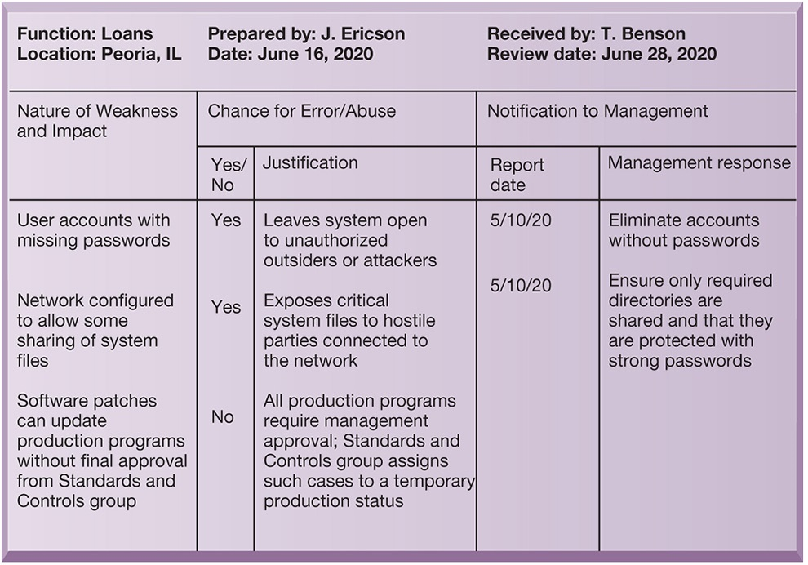
Figure 8.4 Sample Auditor’s List of Control Weaknesses
Notes:
Figure 8.4, Page 314.
This chart is a sample page from a list of control weaknesses that an auditor might find in a loan system in a local commercial bank. This form helps auditors record and evaluate control weaknesses and shows the results of discussing those weaknesses with management as well as any corrective actions management takes.
This graphic illustrates a sample page from an auditor’s listing of control weaknesses for a loan system. It includes a section for notifying management of such weaknesses and for management’s response. Management is expected to devise a plan for countering significant weaknesses in controls.
Alt Text
Long description: A sample table lists control weaknesses that an auditor might identify in a loan system in a local bank. The table lists three types of weaknesses and their impact. The details are as below:
Function: Loans; Location: Peoria, Illinois; Prepared by: J. Ericson; Date: June 16, 2020; Received by: T. Benson; Review date: June 28, 2020.
Nature of weakness and impact: User accounts with missing passwords.
Chance for error or abuse: Yes
Justification: Leaves system open to unauthorized outsiders or attackers
Report date: 10th June, 2020
Management Response: Eliminate accounts without passwords.
Nature of weakness and impact: Network configured to allow some sharing of system files.
Chance for error or abuse: Yes
Justification: Exposes critical system files to hostile parties connected to the network
Report date: 10th June, 2020
Management Response: Ensure only required directories are shared and that they are protected with strong passwords.
Nature of weakness and impact: Software patches can update production programs without final approval from Standards and Controls group
Chance for error or abuse: No
Justification: All production programs require management approval; Standards and Controls group assigns such cases to a temporary production status.
Report date: NA
Management Response: NA.

Slide 32
Tools and Technologies for Safeguarding Information Systems (1 of 3)
Identity management software
  Automates keeping track of all users and privileges
  Authenticates users, protecting identities, controlling access
Authentication
  Password systems
  Tokens
  Smart cards
  Biometric authentication
  Two-factor authentication
Notes:
This slide looks at the technologies used for identifying and authenticating users. Ask students which of the various authentication methods seem to be the most foolproof. Passwords are traditional methods for authentication and newer methods include tokens, smart cards, and biometric authentication. Have any students used authentication methods other than passwords to access a system? Ask students to give examples of things that can be used for biometric authentication (voices, irises, fingerprints, palmprints, face recognition.) Smartphones typically now use fingerprint authentication, and some PCs can be ordered with fingerprint authentication of the user. What are some problems with strict biometric authentication for PCs or smartphones?

Slide 33
Tools and Technologies for Safeguarding Information Systems (2 of 3)
Firewall
  Combination of hardware and software that prevents unauthorized users from accessing private networks
  Packet filtering
  Stateful inspection
  Network address translation (N A T)
  Application proxy filtering
Notes:
This slide looks at an essential tool used to prevent intruders from accessing private networks—firewalls. To create a strong firewall, an administrator must maintain detailed internal rules identifying the people, applications, or addresses that are allowed or rejected. Firewalls can deter, but not completely prevent, network penetration by outsiders and should be viewed as one element in an overall security plan.
Ask students to differentiate between the screening technologies listed here. Note that these are often used in combination.

Slide 34
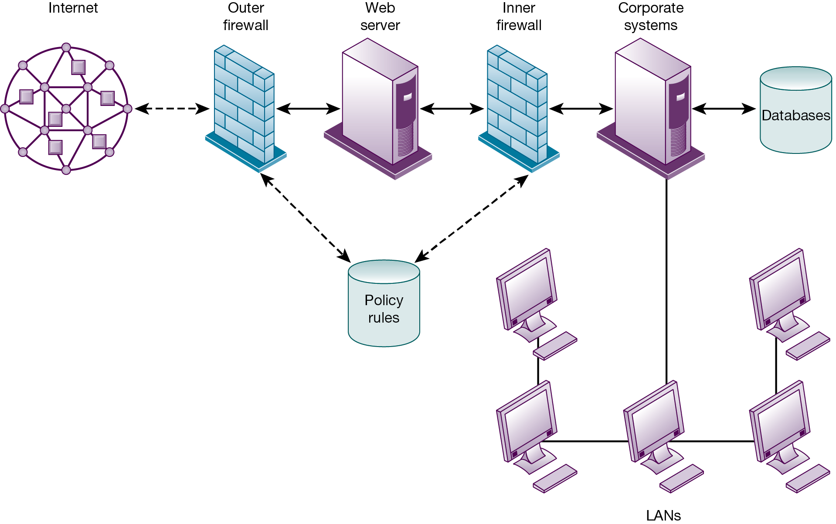
Figure 8.5 A Corporate Firewall
Notes:
Figure 8.5, Page 316.
The firewall is placed between the firm’s private network and the public Internet or another distrusted network to protect against unauthorized traffic.
This graphic illustrates the use of firewalls on a corporate network. Notice that here, a second, “inner” firewall protects the web server from access through the internal network.
Alt Text
Long description: A corporate diagram explains a corporate firewall. The details of the network diagram are as follows:
Internet is connected to the outer firewall, which is further connected to web server. From the web server, the inner firewall is connected to the corporate systems which is further connected to the databases. All the connections are depicted by solid bidirectional arrows.
The outer firewall and inner firewall are connected to policy rules. The connection is depicted by two separate dashed bidirectional arrows.
The corporate systems are connected to the local area network through a wired network.

Slide 35
Tools and Technologies for Safeguarding Information Systems (3 of 3)
Intrusion detection system
  Monitors hot spots on corporate networks to detect and deter intruders
Antimalware and antispyware software
  Checks computers for presence of malware and can often eliminate it as well
  Requires continual updating
Unified threat management (U T M) systems
Notes:
This slide looks at additional tools to prevent unwanted intruders and software from accessing the network. Ask students what anti-malware and antispyware tools they use. Ask why these tools require continual updating. Ask why UTM packages would include anti-spam software.

Slide 36
Securing Wireless Networks
W E P security
  Static encryption keys are relatively easy to crack
  Improved if used in conjunction with V P N
W P A 2 specification
  Replaces W E P with stronger standards
  Continually changing, longer encryption keys
W P A3 is most recent specification, with even stronger encryption
Notes:
This slide looks at the tools and technologies used to secure wireless networks. Ask students with laptops what types of wireless security they have available to them, and which one they use.

Slide 37
Encryption and Public Key Infrastructure (1 of 3)
Encryption
  Transforming text or data into cipher text that cannot be read by unintended recipients
  Two methods for encryption on networks
    Secure Sockets Layer (S S L) and successor Transport Layer Security (T L S)
    Secure Hypertext Transfer Protocol (S-H T T P)
Notes:
This slide introduces the use of encryption to ensure that data traveling along networks cannot be read by unauthorized users. Ask students what encryption involves: use of encryption key (a numerical code) that is used to transform a message into undecipherable text. The cipher text requires a key to be decrypted and read by the recipient.

Slide 38
Encryption and Public Key Infrastructure (2 of 3)
Two methods of encryption of messages
  Symmetric key encryption
    Sender and receiver use single, shared key
  Public key encryption
    Uses two, mathematically related keys: public key and private key
    Sender encrypts message with recipient’s public key
    Recipient decrypts with private key
Notes:
This slide discusses the use of encryption to ensure that data traveling along networks cannot be read by unauthorized users. Ask students to explain the difference between symmetric key encryption and public key encryption. (In symmetric key encryption, the sender and receiver establish a secure Internet session by creating a single encryption key and sending it to the receiver so both the sender and receiver share the same key. Public key encryption uses two keys: one shared (or public) and one totally private. The keys are mathematically related so that data encrypted with one key can be decrypted using only the other key. To send and receive messages, communicators first create separate pairs of private and public keys. The public key is kept in a directory and the private key must be kept secret. The sender encrypts a message with the recipient’s public key. On receiving the message, the recipient uses his or her private key to decrypt it. Ask students why public key encryption is stronger than symmetric key encryption. Note that the strength of an encryption key is measured by its bit length. Today, a typical key will be 128 bits long (a string of 128 binary digits).

Slide 39
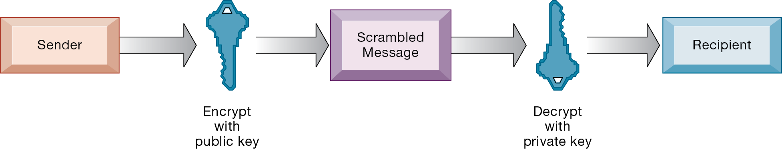
Figure 8.6 Public Key Encryption
Notes:
Figure 8.6, Page 319.
A public key encryption system can be viewed as a series of public and private keys that lock data when they are transmitted and unlock the data when they are received. The sender locates the recipient’s public key in a directory and uses it to encrypt a message. The message is sent in encrypted form over the Internet or a private network. When the encrypted message arrives, the recipient uses his or her private key to decrypt the data and read the message.
This graphic illustrates the steps in public key encryption. The sender encrypts data using the public key of the recipient; data encrypted with this public key can only be decrypted with the recipient’s private key.

Slide 40
Encryption and Public Key Infrastructure (3 of 3)
Digital certificate
  Data file used to establish the identity of users and electronic assets for protection of online transactions
  Uses a trusted third party, certification authority (C A), to validate a user's identity
  C A verifies user’s identity, stores information in C A server, which generates encrypted digital certificate containing owner I D information and copy of owner’s public key
Public key infrastructure (P K I)
  Use of public key cryptography working with certificate authority
  Widely used in e-commerce
Notes:
This slide looks at the use of digital certificates as a tool to help protect online transactions. Digital certificates are used in conjunction with public key encryption to validate the identities of two parties in a transaction before data is exchanged.

Slide 41
Securing Transactions with Blockchain
Secure transaction database
Encryption used to verify users and transactions
Decentralized
Records cannot be changed
Blockchain has some vulnerabilities requiring attention to security and controls

Slide 42
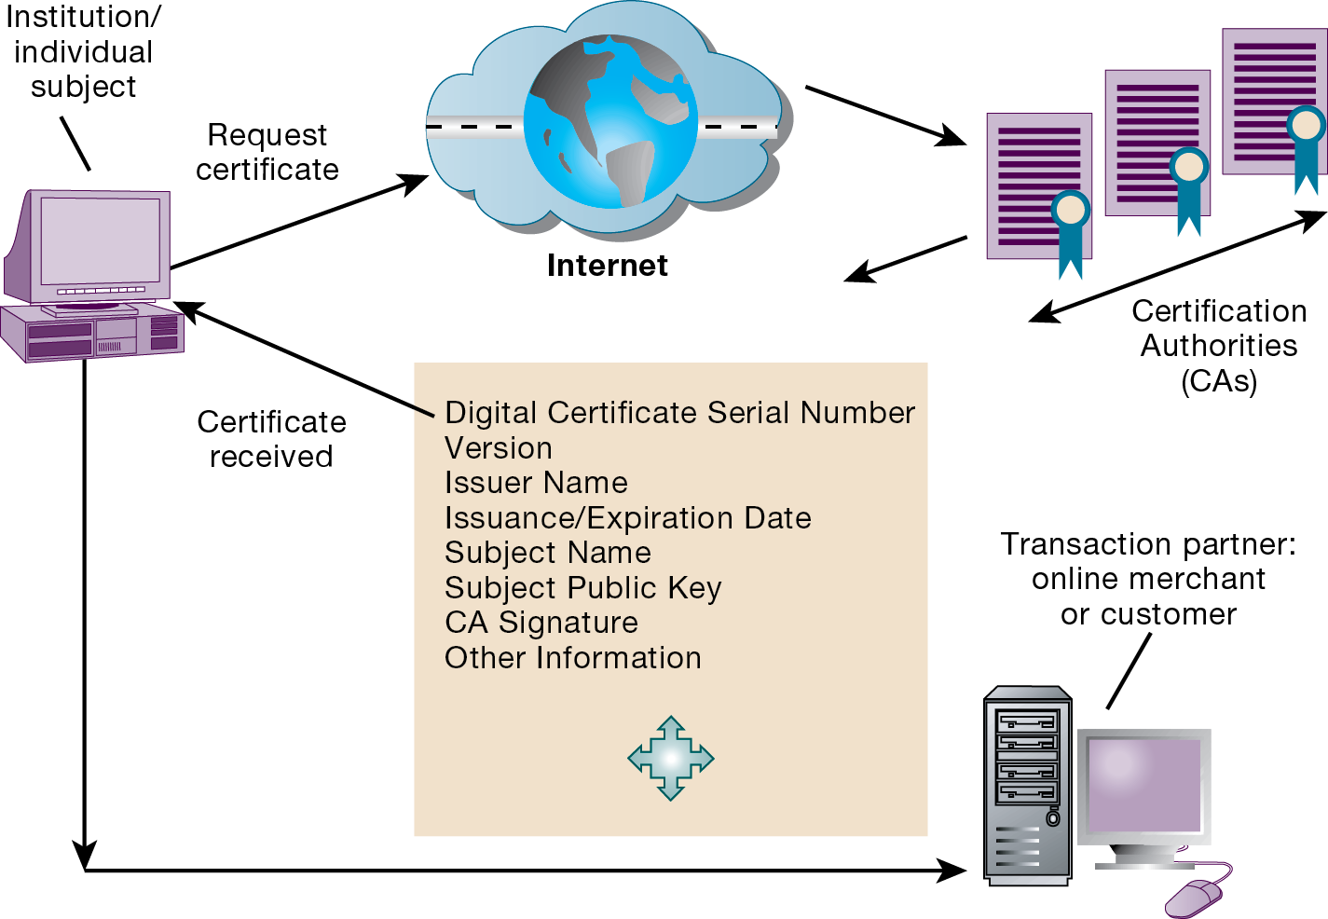
Figure 8.7 Digital Certificates
Notes:
Figure 8.7, Page 320.
Digital certificates help establish the identity of people or electronic assets. They protect online transactions by providing secure, encrypted, online communication.
This graphic illustrates the process for using digital certificates. The institution or individual requests a certificate over the Internet from a CA; the certificate received from the CA can then be used to validate a transaction with an online merchant or customer.
Alt Text
Long description: An illustration explains the concept of digital certificates. The details are as below:
An institution or an individual subject requests a certificate. The request via the internet reaches the certification authorities (CAs). The CAs process the certificate using the below listed credentials:
Digital Certificate Serial Number
Version
Issuer Name
Issuance or Expiration Date
Subject Name
Subject Public Key
CA Signature
Other Information.
The certificate is received by the institution or the individual subject. The institution or the individual subject then connects to the transaction partner. The transaction partner can be a merchant or customer.

Slide 43
Ensuring System Availability
Online transaction processing requires 100% availability
Fault-tolerant computer systems
  Contain redundant hardware, software, and power supply components that create an environment that provides continuous, uninterrupted service
Security outsourcing
  Managed security service providers (M S S P s)
Notes:
This slide looks at technologies and tools for ensuring system availability. Ask students why online transaction processing requires 100% availability. Note that firms with heavy e-commerce processing or for firms that depend on digital networks for their internal operations require at minimum high-availability computing, using tools such as backup servers, distribution of processing across multiple servers, high-capacity storage, and good disaster recovery and business continuity plans.

Slide 44
Achieving Digital Resiliency
Deals with how to maintain and increase resilience of organization and its business processes
Calls attention to managerial and organizational issues in addition to IT infrastructure
Single weak link can cause an outage if resiliency has not been explicitly designed in, measured, and tested

Slide 45
Interactive Session: Management: PayPal Ups Its Digital Resiliency
Class discussion
  Why is digital resiliency so important for a company such as PayPal?
  How did PayPal benefit from measuring its digital resiliency? What issues did it address?
  What is the role of management and organizational issues in making an organization’s IT infrastructure more resilient?

Slide 46
Security Issues for Cloud Computing and the Mobile Digital Platform (1 of 2)
Security in the cloud
  Responsibility for security resides with company owning the data
  Firms must ensure providers provide adequate protection:
    Where data are stored
    Meeting corporate requirements, legal privacy laws
    Segregation of data from other clients
    Audits and security certifications
  Service level agreements (S L A s)
Notes:
This slide describes security concerns specific to cloud computing and mobile computing. Ask students what the key factors are to consider in ensuring a provider has adequate protection (downtime, privacy, and privacy rules in accordance with jurisdiction, external audits, disaster planning).

Slide 47
Security Issues for Cloud Computing and the Mobile Digital Platform (2 of 2)
Securing mobile platforms
  Security policies should include and cover any special requirements for mobile devices
    Guidelines for use of platforms and applications
  Mobile device management tools
    Authorization
    Inventory records
    Control updates
    Lock down/erase lost devices
    Encryption
  Software for segregating corporate data on devices
Notes:
This slide looks at securing mobile systems. What specific concerns are there with mobile devices? One very common security breach involves employees losing phones while traveling. In some cases, the rule is, “lose your phone, lose your job.” Mobile devices such as tablets will increasingly store a considerable amount of corporate information. Then again, if the data is largely stored in the cloud, and passwords are required for access, then the threat is reduced.

Slide 48
Ensuring Software Quality
Software metrics: Objective assessments of system in form of quantified measurements
  Number of transactions
  Online response time
  Payroll checks printed per hour
  Known bugs per hundred lines of code
Early and regular testing
Walkthrough: Review of specification or design document by small group of qualified people
Debugging: Process by which errors are eliminated
Notes:
This slide looks at ensuring software quality as a way to improve system quality and reliability by employing software metrics and rigorous software testing. Ongoing use of metrics allows the information systems department and end users to jointly measure the performance of the system and identify problems as they occur.

Slide 49
How Will M I S Help My Career?
The Company: No. 1 Value Supermarkets
Position Description: Identity access and management support specialist, entry-level
Job Requirements
Interview Questions
Author Tips
Notes:
A good opportunity for a class discussion of the new Section on careers. Would any in the class be interested in a job like this? What do they think are the most important skills the employer is looking for? How would they answer the interviewer questions?

Slide 50

Copyright
This work is protected by United States copyright laws and is provided solely for the use of instructors in teaching their courses and assessing student learning. Dissemination or sale of any part of this work (including on the World Wide Web) will destroy the integrity of the work and is not permitted. The work and materials from it should never be made available to students except by instructors using the accompanying text in their classes. All recipients of this work are expected to abide by these restrictions and to honor the intended pedagogical purposes and the needs of other instructors who rely on these materials.

